Slide 1

Advanced Trees and Applications Data Structures-II
Dr. Dattatray G. Takale
Dattatray.takale@viit.ac.in
Department of Data Science
BRACT’S, Vishwakarma Institute of Information Technology, Pune-48
(An Autonomous Institute affiliated to Savitribai Phule Pune University)
(NBA and NAAC accredited, ISO 9001:2015 certified)

Slide 2
Unit -1 :Contents
Threaded Binary Tree, AVL Tree, Red-Black Tree, Heap Tree, Huffman Tree. B-Tree, B+-Tree, Splay Tree, Van Emde Boas Tree, Fusion Tree, Dynamic Finger Search Trees with Time and Space Complexity Analysis
Dr. Dattatray G Takale, Department of Computer Engineering, VIT, Pune-37

Slide 3
Linear and Non- Linear Data Structure
Data structures can be broadly classified into two categories based on how they organize data: linear and non-linear. Each type has its own specific use cases and advantages in different programming scenarios
Linear Data Structures: Linear data structures organize data elements in a sequential manner, where each element is connected to its previous and next element. This sequential layout makes linear data structures easy to implement and use
Non- Linear Data Structures: Non-linear data structures do not organize data in a sequential manner but instead, they use a hierarchical relationship among elements.
Dr. Dattatray G Takale, Department of Computer Engineering, VIT, Pune-37

Slide 4
Sr. No. | Key | Linear Data Structures | Non-linear Data Structures
1 | Data Element Arrangement | In linear data structure, data elements are sequentially connected and each element is traversable through a single run. | In non-linear data structure, data elements are hierarchically connected and are present at various levels.
2 | Levels | In linear data structure, all data elements are present at a single level. | In non-linear data structure, data elements are present at multiple levels.
3 | Predecessor and Successor | Every element can have at the max one successor and one predecessor. 11 ,1 , 2 ,3 | this each element can have more than one successor.
4 | Implementation complexity | Linear data structures are easier to implement. | Non-linear data structures are difficult to understand and implement as compared to linear data structures.
5 | Traversal | Linear data structures can be traversed completely in a single run. | Non-linear data structures are not easy to traverse and needs multiple runs to be traversed completely.
Dr. Dattatray G Takale, Department of Computer Engineering, VIT, Pune-37

Slide 5
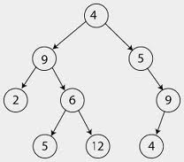
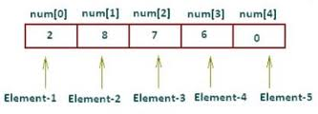

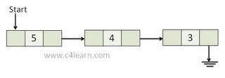
Sr. No. | Key | Linear Data Structures | Non-linear Data Structures
6 | Memory utilization | Linear data structures are not very memory friendly and are not utilizing memory efficiently. | Non-linear data structures uses memory very efficiently.
7 | Time Complexity | Time complexity of linear data structure often increases with increase in size. | Time complexity of non-linear data structure often remain with increase in size.
8 | Examples | Array Linked List Queue, Stack. | Tree Graph Map
Dr. Dattatray G Takale, Department of Computer Engineering, VIT, Pune-37

Slide 6
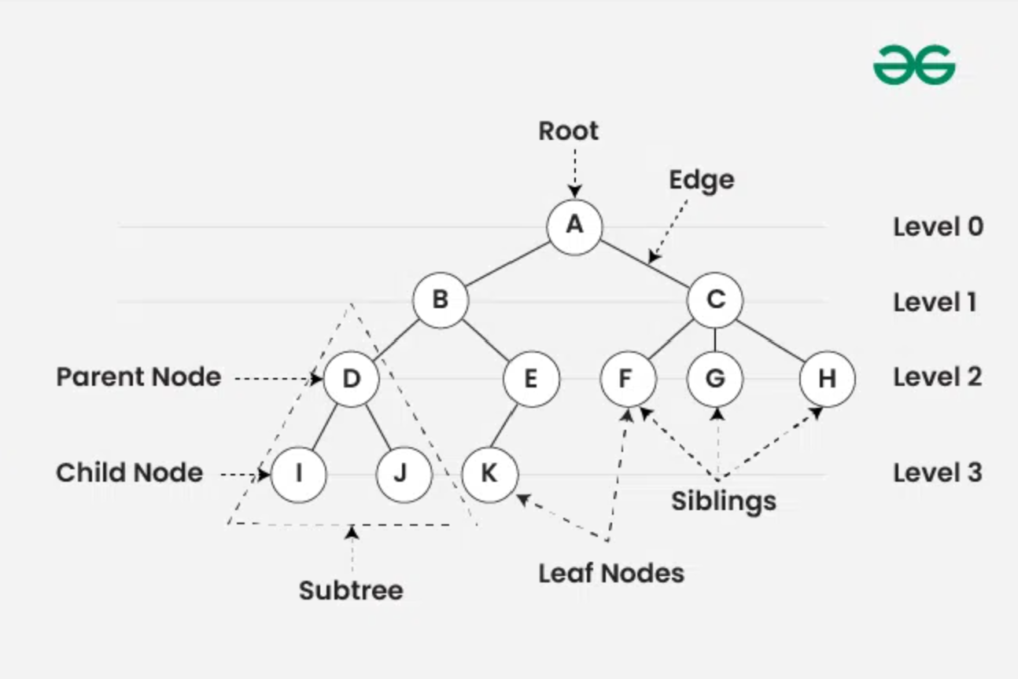
Tree
Tree data structure is a specialized data structure to store data in hierarchical manner. It is used to organize and store data in the computer to be used more effectively. It consists of a central node, structural nodes, and sub-nodes, which are connected via edges. We can also say that tree data structure has roots, branches, and leaves connected.
Dr. Dattatray G Takale, Department of Computer Engineering, VIT, Pune-37

Slide 7
Tree
A tree is a widely used abstract data type that simulates a hierarchical tree structure, with a root value and subtrees of children with a parent node, represented as a set of linked nodes. Here’s a detailed overview of the tree data structure in computer science:
Tree can be defined as a Collection of entities (Notes), linked together to simulate a Hierarchy
File System Hierarchy
Description: Operating systems organize files and directories within a tree structure. Each directory can contain files or subdirectories, making it a tree node, with the root directory at the base.
Utility: This organization allows users and programs to find files quickly and manage them efficiently, using paths represented as branches from the root to the desired file or folder.
Dr. Dattatray G. Takale, Department of Computer engineering, VIIT, Pune-48

Slide 8
Tree
Organizational Structures
Description: Many organizations chart their structure using a tree to represent different levels of hierarchy, where the CEO is at the root, and subsequent levels represent managers and their subordinates.
Utility: This helps visualize and manage the reporting relationships and workflow within an organization.
Dr. Dattatray G Takale, Department of Computer Engineering, VIT, Pune-37

Slide 9
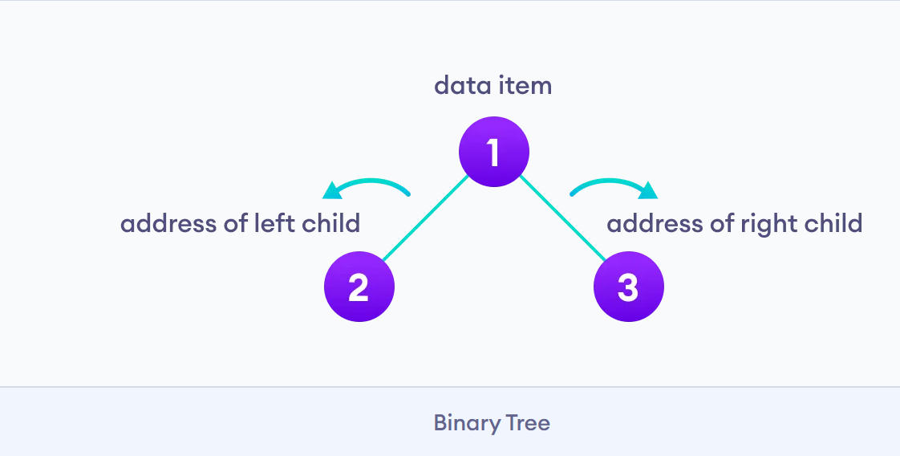
Binary Tree
A binary tree is a tree data structure in which each parent node can have at most two children. Each node of a binary tree consists of three items
Data item
Address of left child
Address of right child
Types of Binary Tree
Dr. Dattatray G Takale, Department of Computer Engineering, VIT, Pune-37

Slide 10
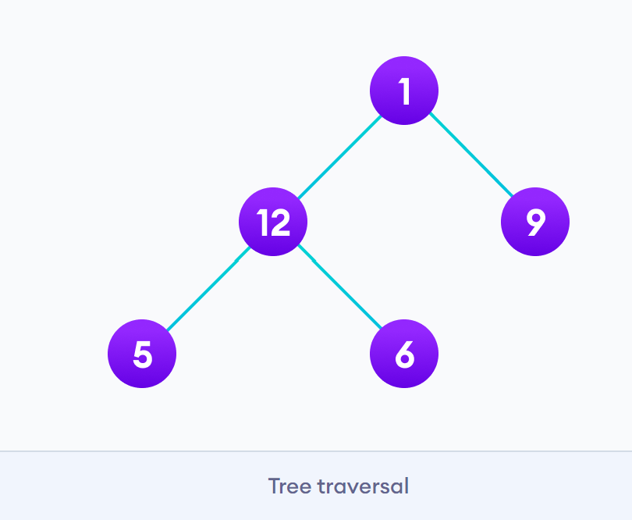
Traversal in Tree: inorder, preorder and postorder
Traversing a tree means visiting every node in the tree.
For Example: Top, Left to Right
Tree Types of Traversal
In order
Pre order
Post order
Dr. Dattatray G Takale, Department of Computer Engineering, VIT, Pune-37

Slide 11
Traversal in Tree: inorder, preorder and postorder
In-Order Traversal (Left, Root, Right)
Visit the left subtree first.
Visit the root node.
Visit the right subtree.
Pre-Order Traversal (Root, Left, Right)
Visit the root node first.
Visit the left subtree.
Visit the right subtree.
Post-Order Traversal (Left, Right, Root)
Visit the left subtree first.
Visit the right subtree.
Visit the root node.
Dr. Dattatray G Takale, Department of Computer Engineering, VIT, Pune-37

Slide 12
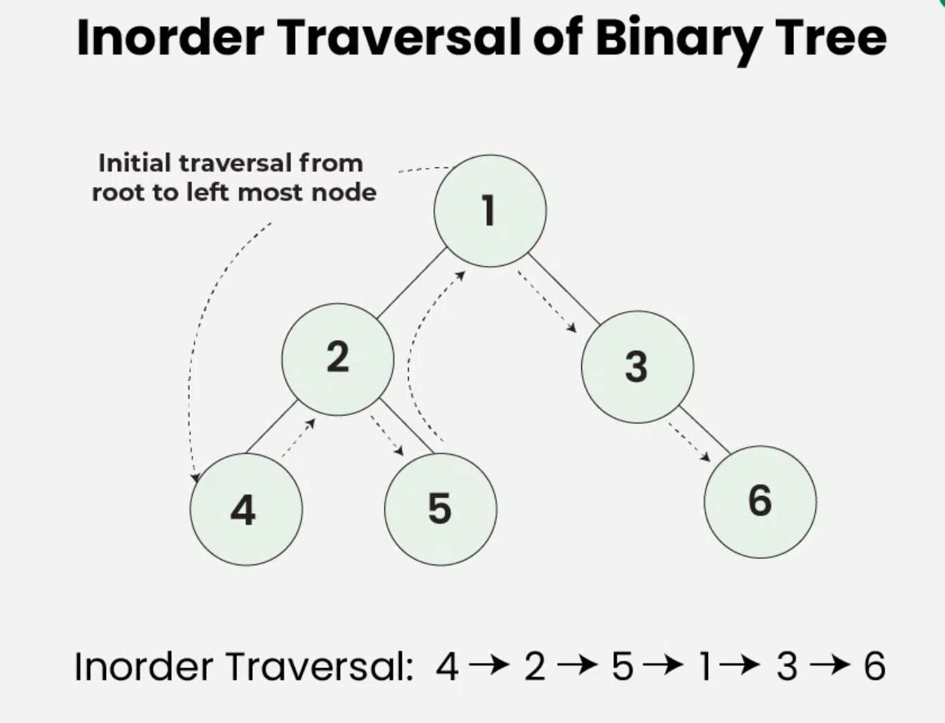
Traversal in Tree: inorder, preorder and postorder
Dr. Dattatray G Takale, Department of Computer Engineering, VIT, Pune-37

Slide 13
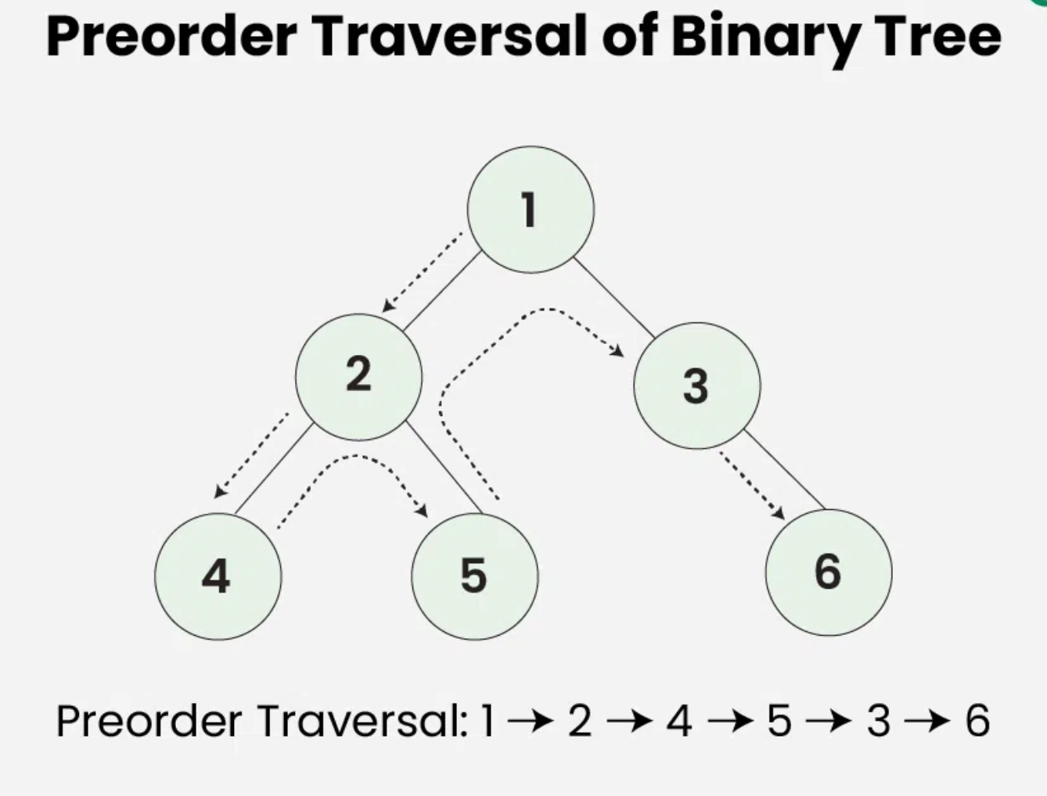
Traversal in Tree: inorder, preorder and postorder
Dr. Dattatray G Takale, Department of Computer Engineering, VIT, Pune-37

Slide 14
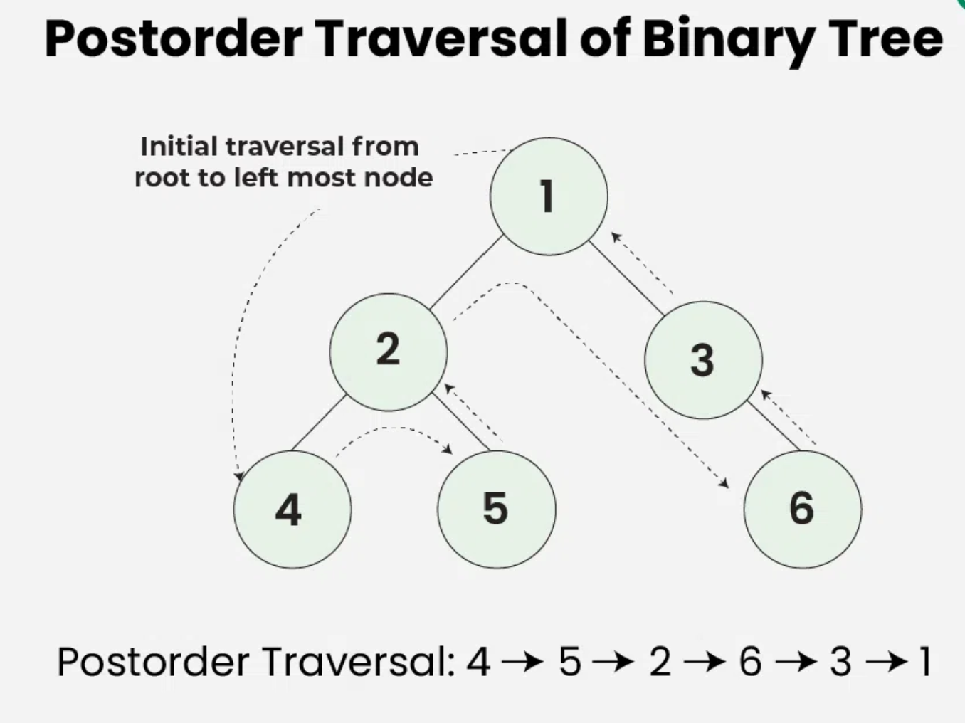
Traversal in Tree: inorder, preorder and postorder
Dr. Dattatray G Takale, Department of Computer Engineering, VIT, Pune-37

Slide 15
Threaded Binary Tree
In a normal binary tree, many left and right pointers are NULL. In inorder traversal, we need recursion or a stack, which consumes extra memory
In an n-node binary tree → n+1 NULL pointers
Instead of wasting these NULL pointers, we can use them to store useful information
Replace NULL pointers with special links
These links point to the inorder predecessor or successor.
These special links are called threads
A Threaded Binary Tree is a binary tree in which NULL child pointers are replaced by threads that point to the inorder predecessor or successor, enabling traversal without recursion or stack
Dr. Dattatray G Takale, Department of Computer Engineering, VIT, Pune-37

Slide 16
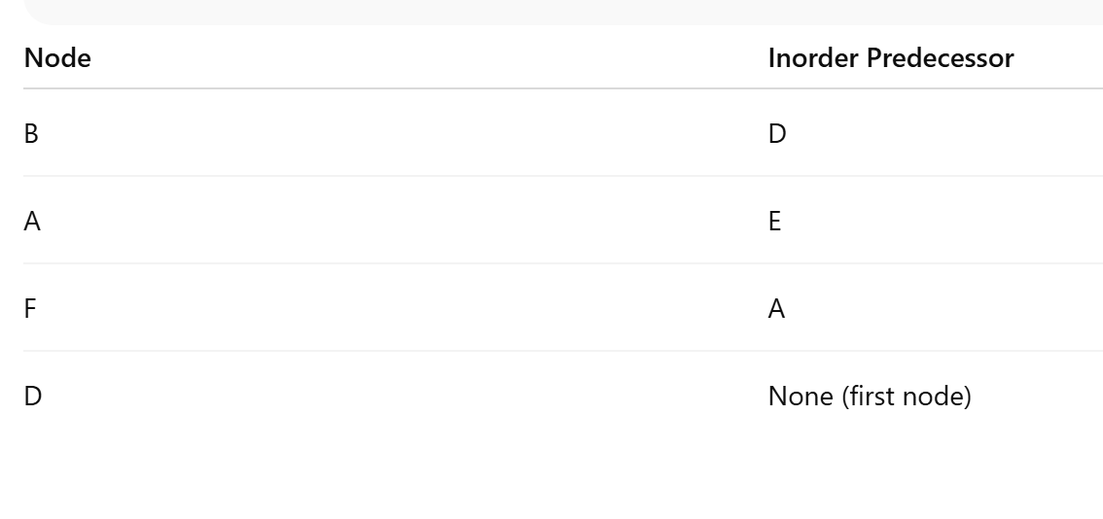
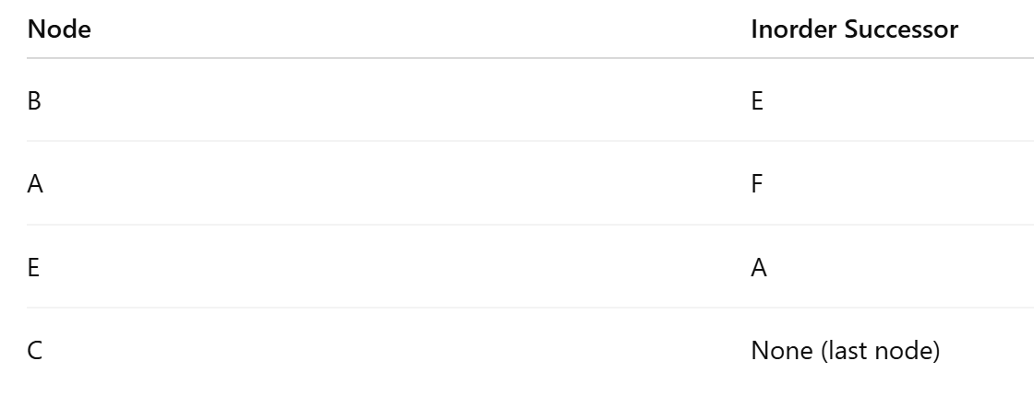
Threaded Binary Tree
Inorder traversal of a binary tree follows the order:
Left Subtree → Root → Right Subtree
This produces a linear sequence of nodes.
D B E A F C
Inorder Predecessor: The inorder predecessor of a node is the node that appears immediately before it in the inorder traversal sequence.
Inorder Successor: The inorder successor of a node is the node that appears immediately after it in the inorder traversal sequence.
Dr. Dattatray G Takale, Department of Computer Engineering, VIT, Pune-37

Slide 17
Threaded Binary Tree
A binary tree can be represented using array representation or linked list representation.
When a binary tree is represented using linked list representation, the reference part of the node which doesn't have a child is filled with a NULL pointer.
In any binary tree linked list representation, there is a number of NULL pointers than actual pointers.
Generally, in any binary tree linked list representation, if there are 2N number of reference fields, then N+1 number of reference fields are filled with NULL ( N+1 are NULL out of 2N ). This NULL pointer does not play any role except indicating that there is no link (no child).
A. J. Perlis and C. Thornton have proposed new binary tree called "Threaded Binary Tree", which makes use of NULL pointers to improve its traversal process. In a threaded binary tree, NULL pointers are replaced by references of other nodes in the tree. These extra references are called as threads.
Threaded Binary Tree is also a binary tree in which all left child pointers that are NULL (in Linked list representation) points to its in-order predecessor, and all right child pointers that are NULL (in Linked list representation) points to its in-order successor.
Dr. Dattatray G Takale, Department of Computer Engineering, VIT, Pune-37

Slide 18
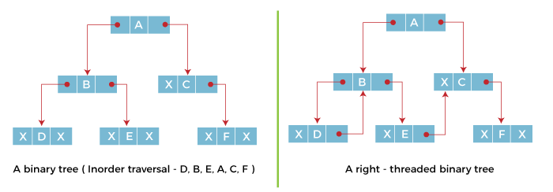
Types Threaded Binary Tree
Single Threaded Binary Tree (STBT)
A Single Threaded Binary Tree (STBT) is a binary tree in which only one type of NULL pointer (either left or right) is replaced by a thread.
The thread connects a node to its inorder predecessor or inorder successor
Only one direction is threaded (not both)
Advantage of STBT:
Inorder traversal without recursion
Better memory utilization
Simpler than double-threaded trees
Faster traversal than normal trees
Disadvantages of STBT
Only one-direction traversal
Insertion & deletion are complex
Less powerful than fully threaded trees
Dr. Dattatray G Takale, Department of Computer Engineering, VIT, Pune-37

Slide 19
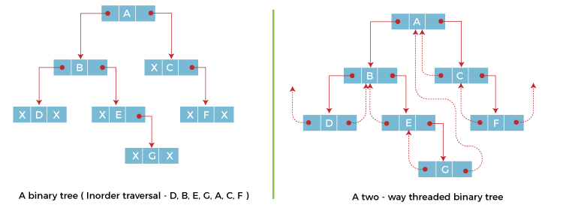
Types Threaded Binary Tree
Double Threaded Binary Tree (STBT)
A Double Threaded Binary Tree (DTBT) (also called a Fully Threaded Binary Tree) is a binary tree in which both left and right NULL child pointers are replaced by threads.
Left thread → points to the inorder predecessor
Right thread → points to the inorder successor
Thus, every node can directly reach its previous and next node in inorder traversal.
Advantages
Inorder traversal without recursion or stack
Two-way traversal (forward & backward) Direct access to predecessor and successor Better utilization of NULL pointers
Disadvantages
Complex insertion and deletion
Extra tag bits required
Rarely used in modern libraries due to complexity
Dr. Dattatray G Takale, Department of Computer Engineering, VIT, Pune-37

Slide 20
Step of Converting Binary Tree to Threaded Binary Tree
Step 1: Perform Inorder Traversal
Write the inorder sequence of the binary tree and linked list representation of Binary Tree
Step 2: Identify NULL Pointers
For each node:
If left child = NULL → candidate for left thread
If right child = NULL → candidate for right thread
Step 3: Add Threads
Left NULL pointer → connect to inorder predecessor
Right NULL pointer → connect to inorder successor
Step 4: Set Tag Bits
lTag = 1 → left pointer is a thread
rTag = 1 → right pointer is a thread
Tag = 0 → actual child link
Step 5: Creating a Dummy (Header) Node for Leftmost & Rightmost Nodes
Dr. Dattatray G Takale, Department of Computer Engineering, VIT, Pune-37

Slide 21
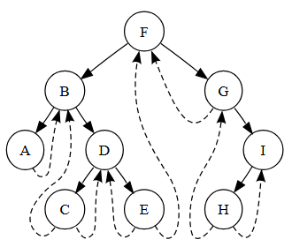
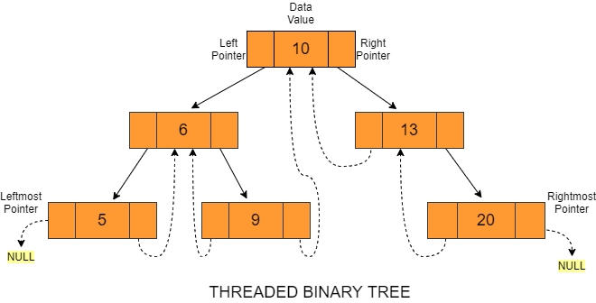
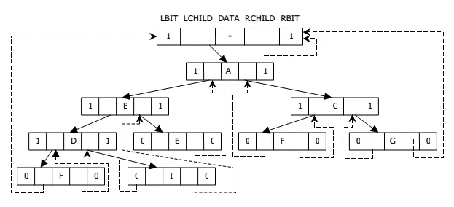
Threaded Binary Tree
Dr. Dattatray G Takale, Department of Computer Engineering, VIT, Pune-37

Slide 22
Threaded Binary Tree
struct Node {
int data;
Node *left, *right;
bool lthread, rthread;
};
Node* createNode(int data) {
Node* temp = new Node;
temp->data = data;
temp->left = temp->right = NULL;
temp->lthread = true; // left is thread
temp->rthread = true; // right is thread
return temp;
}
Dr. Dattatray G Takale, Department of Computer Engineering, VIT, Pune-37

Slide 23
Why Threaded Binary Tree is Needed?
In a normal binary tree:
Many left/right pointers are NULL
During traversal, we need:
Stack
Recursion
Problem:
Extra memory usage
Slower traversal
Solution:
➡ Use those NULL pointers as threads
Advantages of TBT
Efficient memory utilization
Faster traversal
No recursion or stack
Direct access to predecessor and successor
Disadvantages
Insertion & deletion are complex
Extra tag bits required
Rare in practical libraries
Dr. Dattatray G Takale, Department of Computer Engineering, VIT, Pune-37

Slide 24
Threaded Binary Tree
What is a threaded binary tree?
Why are NULL pointers replaced in a threaded binary tree?
Define inorder predecessor and inorder successor.
What is the purpose of thread links in a binary tree?
What is meant by single threaded binary tree?
What is a double threaded binary tree?
What are 1Tag and 0Tag in a threaded binary tree?
How many NULL pointers are present in an n-node binary tree?
State one advantage of a threaded binary tree.
Can inorder traversal be done without recursion in a threaded binary tree? Why?
Dr. Dattatray G Takale, Department of Computer Engineering, VIT, Pune-37

Slide 25
AVL Tree
The AVL tree is named after its inventors, Adelson-Velskii and Landis, who published it in their 1962 paper “An algorithm for the organization of information
If a node's longest path in its left subtree is longer than its longest path in its right subtree, the node is said to be "left heavy."
If the longest path in a node's right subtree is one more long than the longest path in its left subtree, the node is said to be "right heavy."
If the longest paths in the right and left subtrees are equal, a node is said to be balanced.
An AVL tree defined as a self-balancing Binary Search Tree (BST) where the difference between heights of left and right subtrees for any node cannot be more than one.
An AVL tree is a self-balancing binary search tree (BST) that automatically adjusts its structure after insertions and deletions to maintain balance, ensuring efficient O(log n) time for search, insertion, and deletion
The difference between the heights of the left subtree and the right subtree for any node is known as the balance factor of the node.
Dr. Dattatray G. Takale, Department of Computer engineering, VIIT, Pune-48

Slide 26
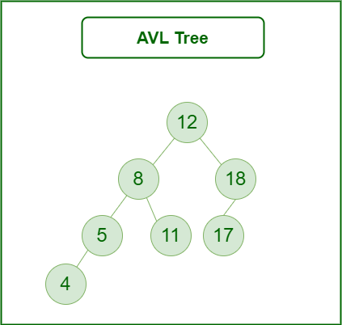
AVL Tree
AVL Trees are Self-Balanced Binary Search Trees.
In AVL trees, the balancing factor of each node is either 0 or 1 or -1.
Balance Factor of AVL Tree calculated as = Height of Left Sub-tree - Height of Right Sub-tree
Construction of AVL Trees -
Insertion Operation is performed to construct the AVL Tree.
Inserting the element in the AVL tree is same as the insertion performed in BST.
After insertion, check the balance factor of each node of the resulting tree.
After the insertion, the balance factor of each node is either 0 or 1 or -1, then the tree is considered to be balanced, concludes the operation, and inserts the next element if any.
After the insertion, the balance factor of at least one node is not 0 or 1 or -1, then the tree is considered to be imbalanced, perform the suitable rotation to balance the tree, and after the tree is balanced, insert the next element if any.
Dr. Dattatray G. Takale, Department of Computer engineering, VIIT, Pune-48

Slide 27
AVL Tree
Rotations used to Balance the AVL Tree -
After inserting an element in the AVL tree,
If a tree becomes imbalanced, then there exists one particular node in the tree by balancing which the entire tree becomes balanced automatically.
To rebalance the tree, balance that particular node.
To find that particular node:
Traverse the path from the newly inserted node to the root node.
Check the balance factor of each node that is encountered while traversing the path.
The first encountered imbalanced node will be the node that needs to be balanced.
To balance that node:
Count three nodes in the direction of the leaf node.
Then, use the concept of AVL Tree Rotations to rebalance the tree.
LL Rotation - In LL rotation, every node moves one position to left from the current position.
RR Rotation - In RR rotation, every node moves one position to right from the current position.
LR Rotation - In LR rotation, at first, every node moves one position to the left and then one position to right from the current position.
RL Rotation - In RL rotation, at first every node moves one position to right and then one position to left from the current position.
Dr. Dattatray G. Takale, Department of Computer engineering, VIIT, Pune-48

Slide 28
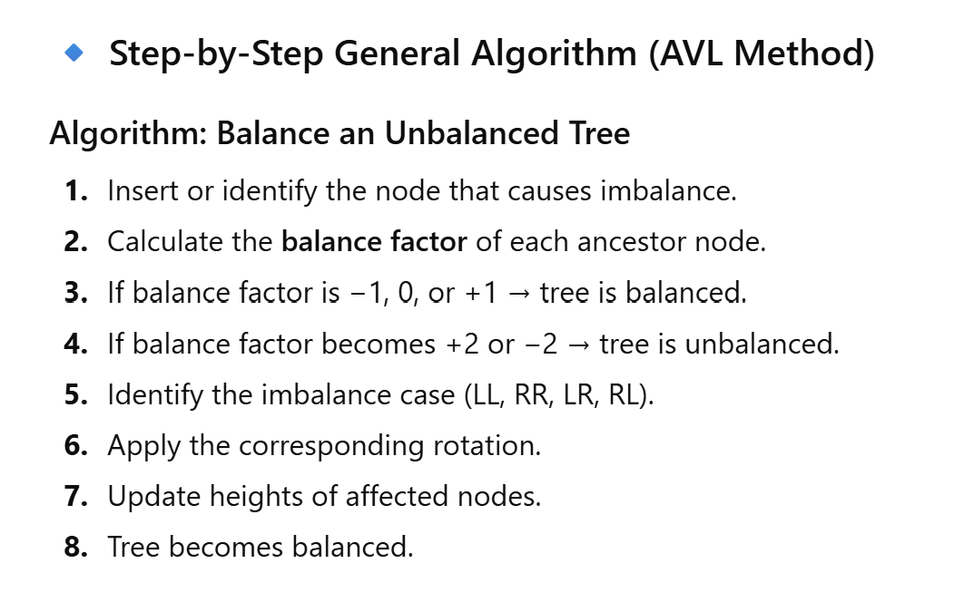
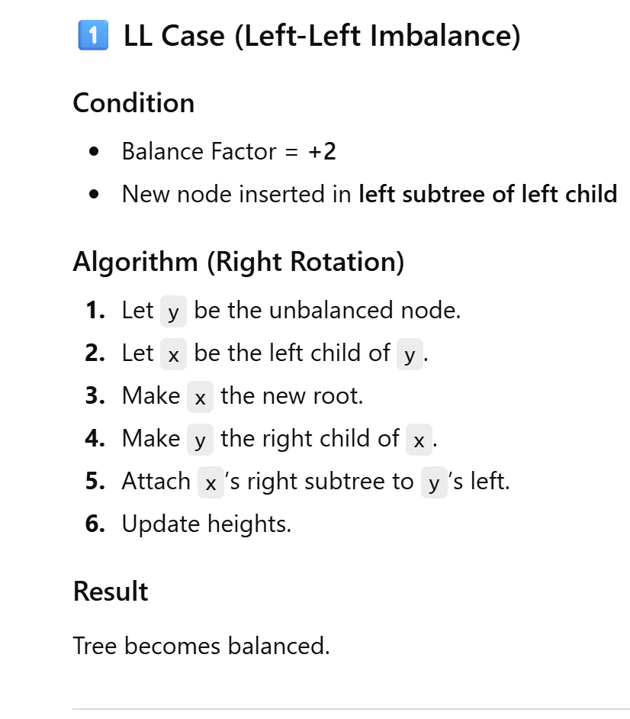
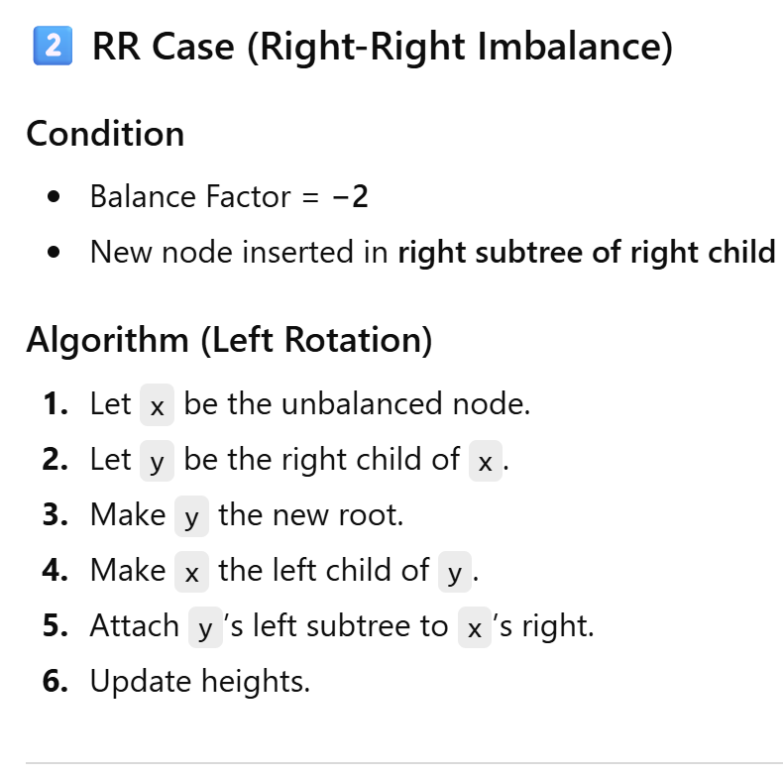
AVL Tree
Dr. Dattatray G. Takale, Department of Computer engineering, VIIT, Pune-48

Slide 29
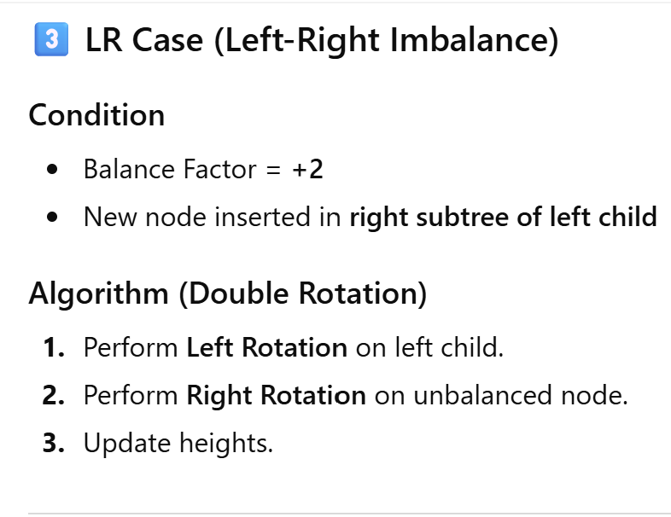
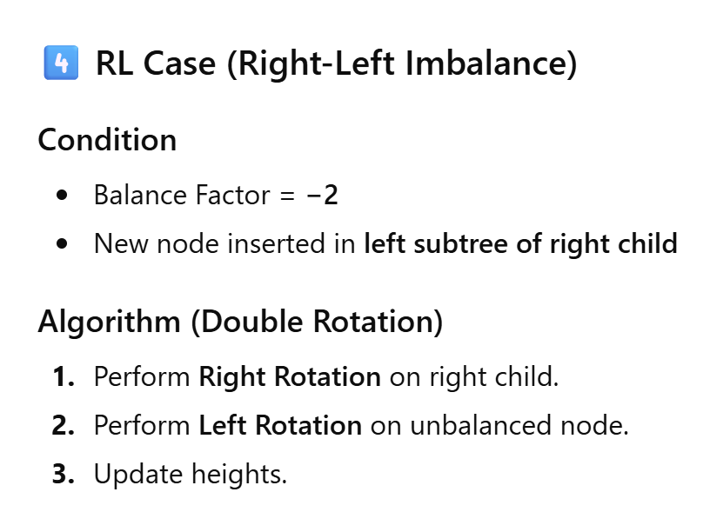
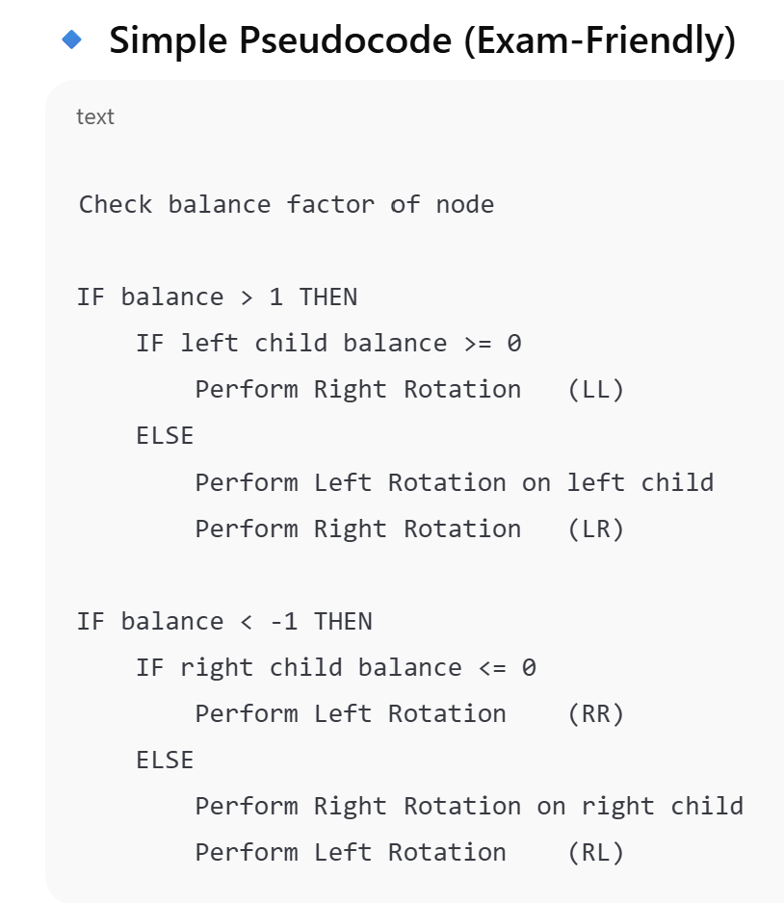
AVL Tree
Dr. Dattatray G. Takale, Department of Computer engineering, VIIT, Pune-48

Slide 30
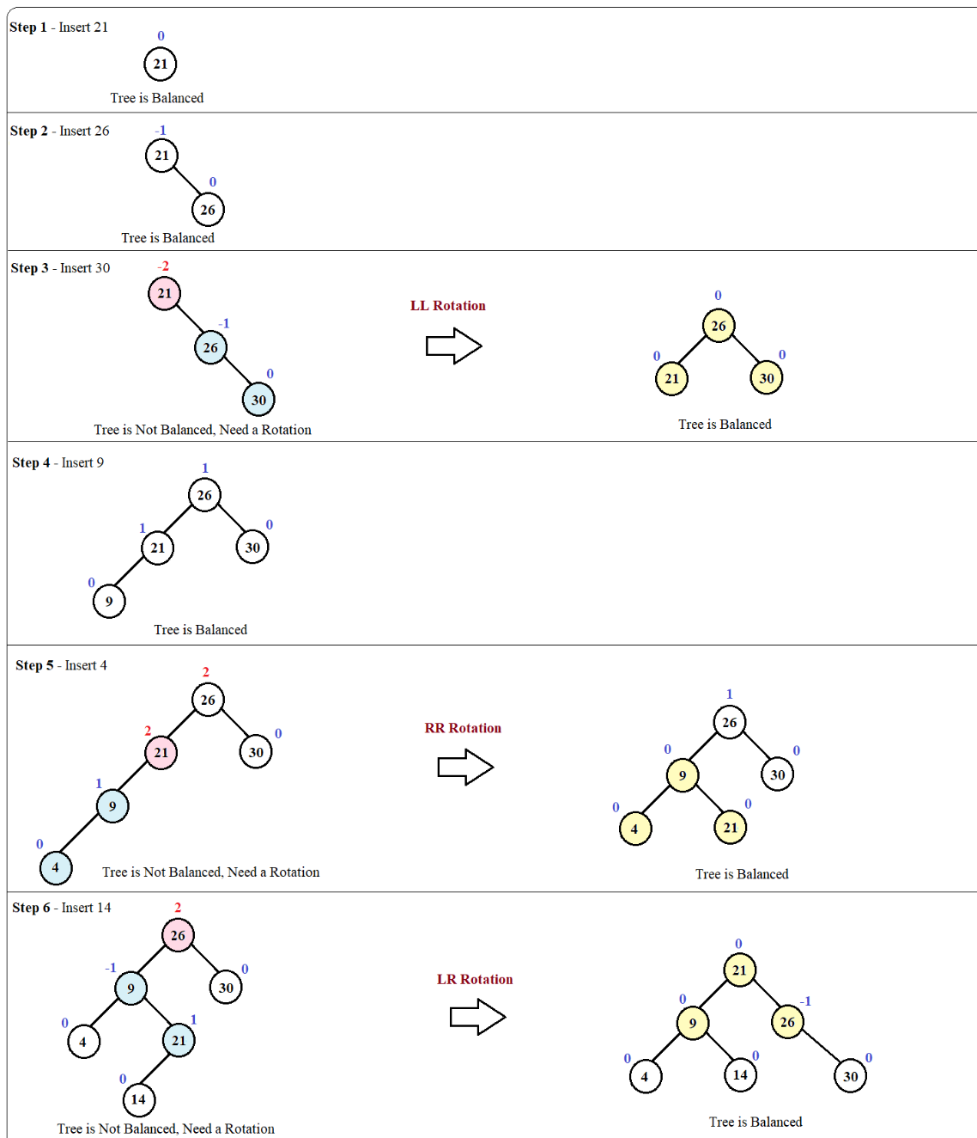
Step-by-Step Construction of the AVL Tree for the given Sequence 21, 26, 30, 9, 4, 14, 28, 18,15,10, 2, 3, 7
Dr. Dattatray G. Takale, Department of Computer engineering, VIIT, Pune-48

Slide 31
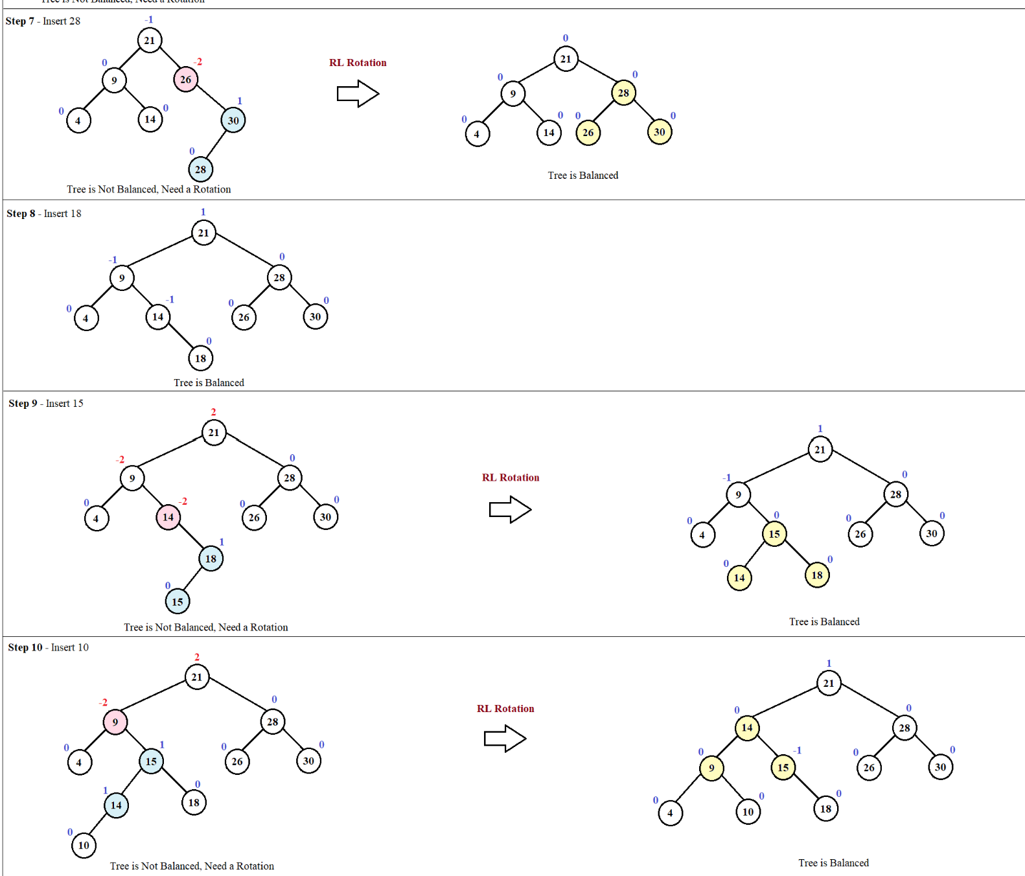
AVL Tree
Dr. Dattatray G. Takale, Department of Computer engineering, VIIT, Pune-48

Slide 32
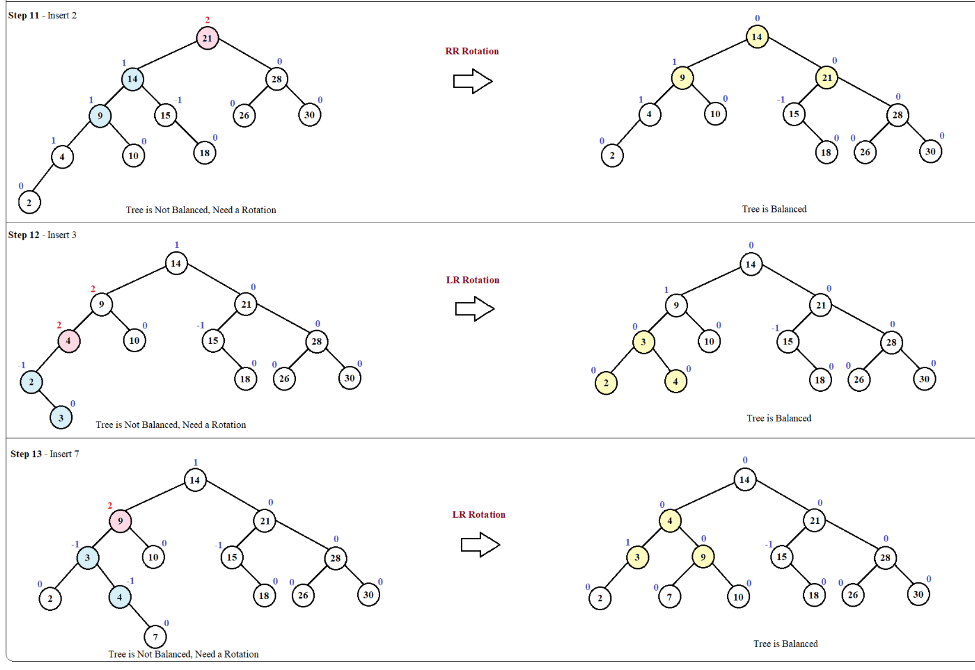
AVL Tree
Dr. Dattatray G. Takale, Department of Computer engineering, VIIT, Pune-48

Slide 33
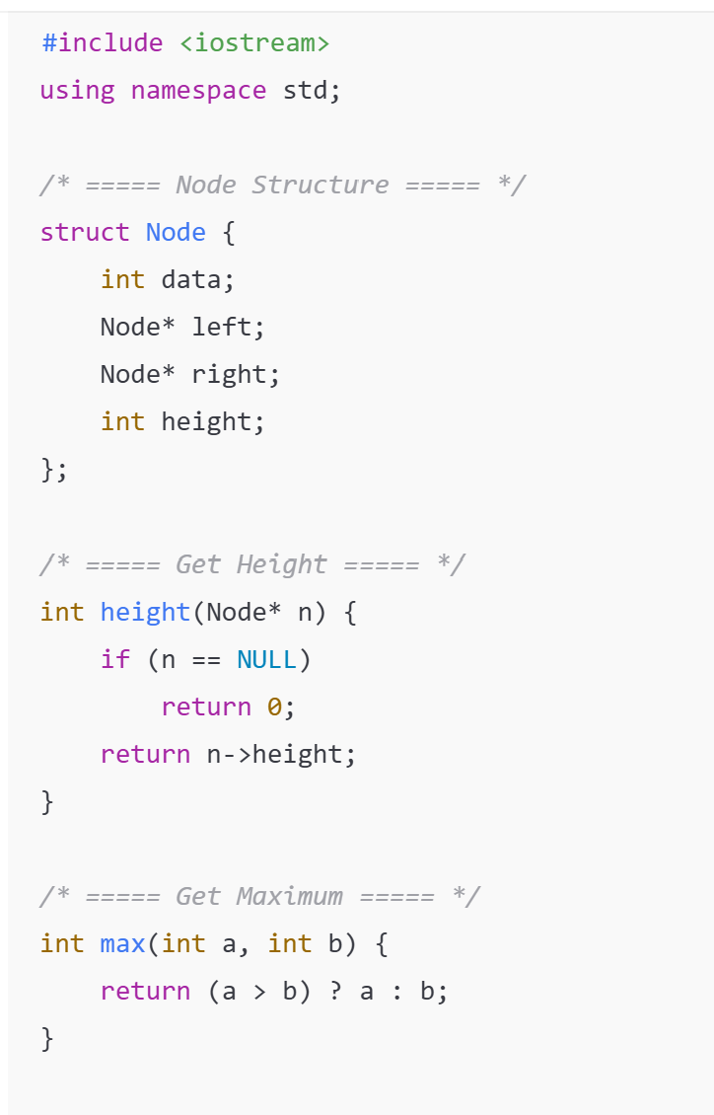
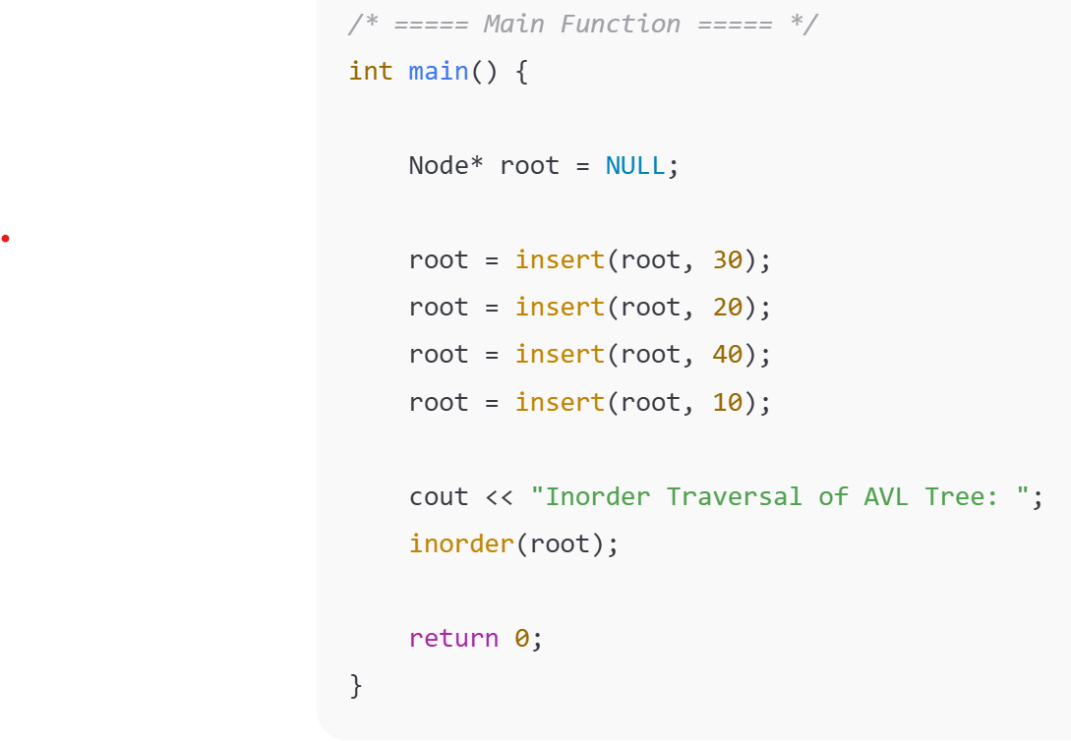
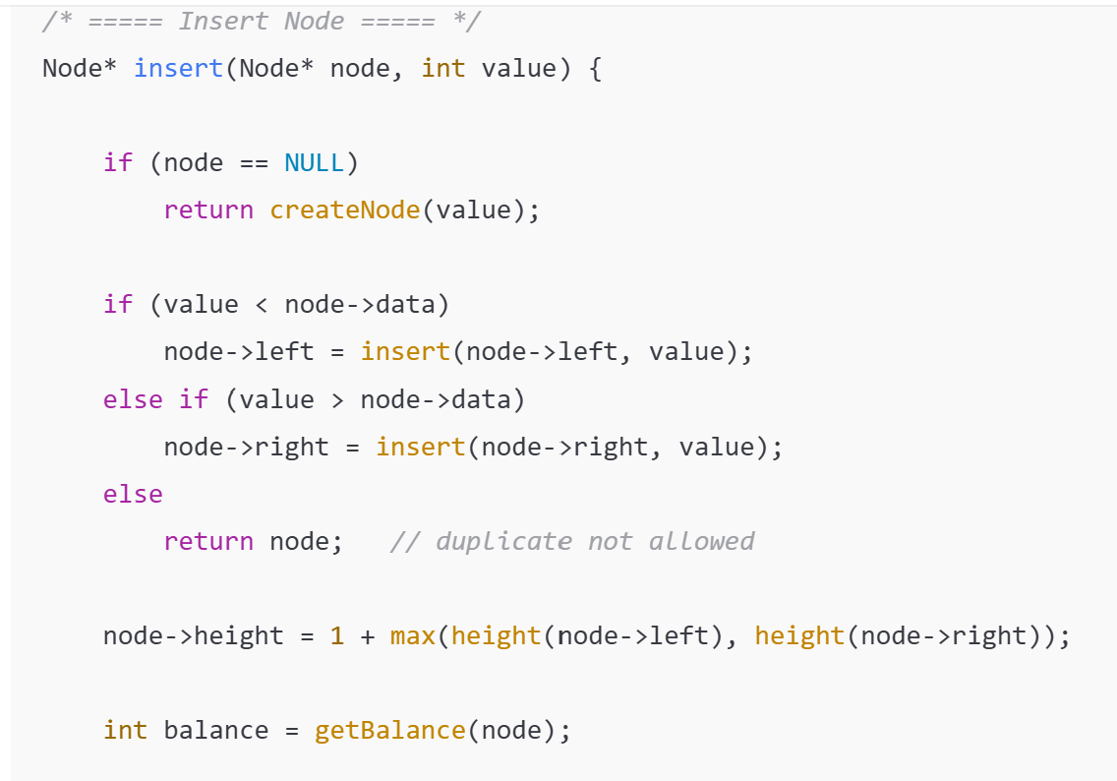
AVL Tree
Dr. Dattatray G. Takale, Department of Computer engineering, VIIT, Pune-48

Slide 34
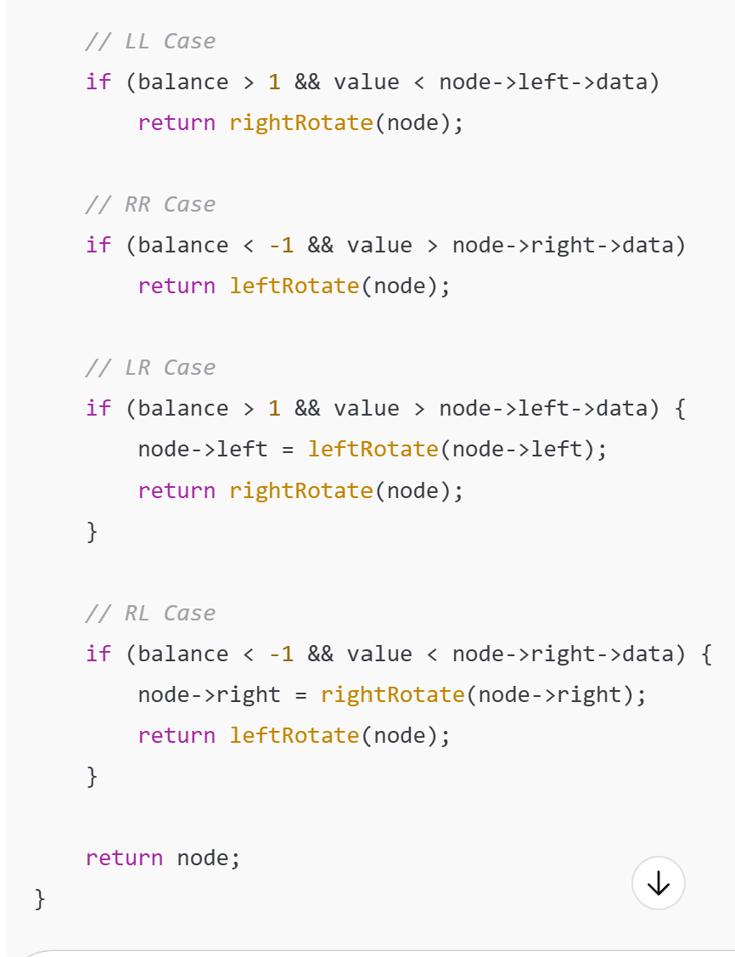
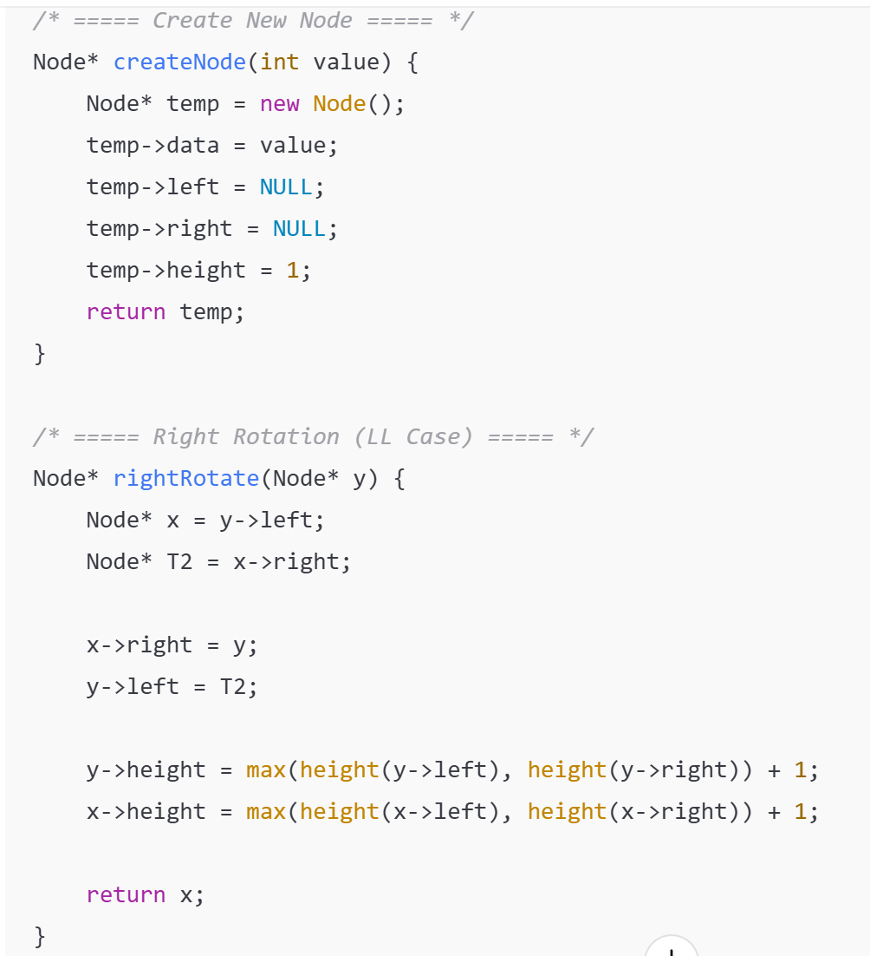
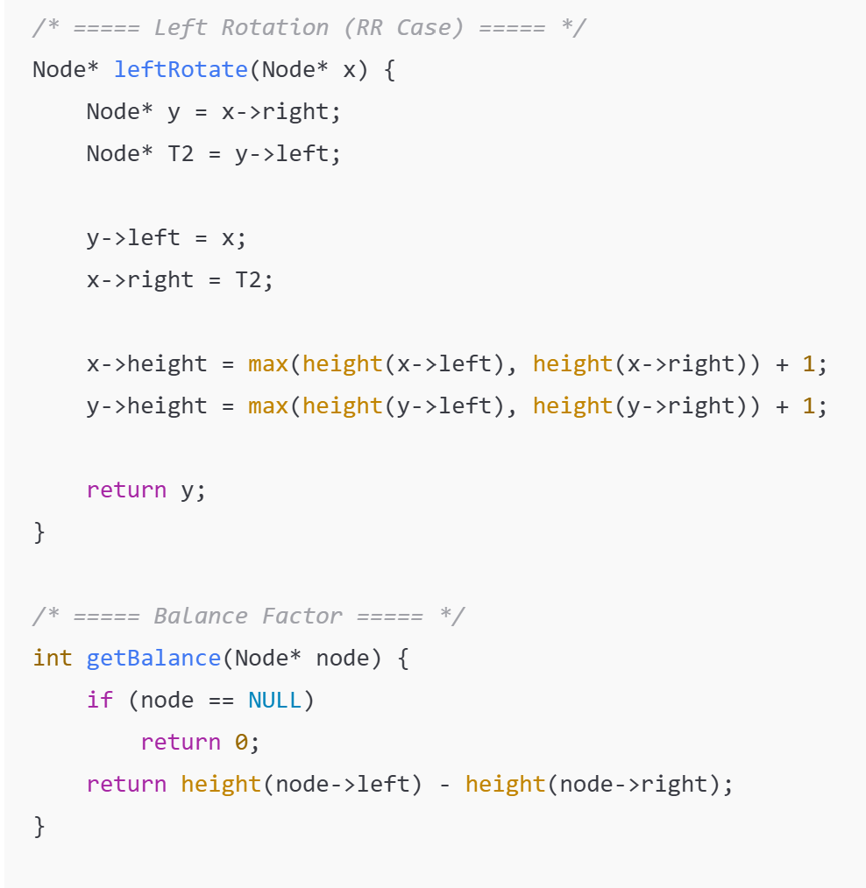
AVL Tree
Dr. Dattatray G. Takale, Department of Computer engineering, VIIT, Pune-48

Slide 35
AVL Tree
What is an AVL Tree?
What does AVL stand for?
What does AVL stand for?
What is balance factor?
What are allowed balance factor values in AVL Tree?
What is the height of a node?
What is the height of a leaf node in AVL Tree?
When does an AVL Tree become unbalanced?
What is rotation in AVL Tree?
How many types of rotations are there?
When is LL rotation used?
When is RR rotation used?
When is LR rotation used?
When is RL rotation used?
What is the time complexity of insertion in AVL Tree?
What is the time complexity of search in AVL Tree?
Which traversal shows sorted order in AVL Tree?
Difference between BST and AVL Tree?
Which is faster: BST or AVL Tree?
Why are rotations required in AVL Tree?
Is AVL Tree always balanced?
Can AVL Tree have duplicate keys?
Is AVL Tree a complete binary tree?
Dr. Dattatray G. Takale, Department of Computer engineering, VIIT, Pune-48

Slide 36
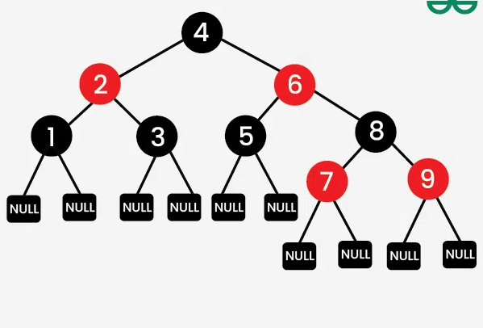
Red Black Tree
Binary search trees are a fundamental data structure, but their performance can suffer if the tree becomes unbalanced. Red Black Trees are a type of balanced binary search tree that use a set of rules to maintain balance, ensuring logarithmic time complexity for operations like insertion, deletion, and searching, regardless of the initial shape of the tree. Red Black Trees are self-balancing, using a simple color-coding scheme to adjust the tree after each modification.
Dr. Dattatray G. Takale, Department of Computer engineering, VIIT, Pune-48

Slide 37
Red Black Tree
A Red-Black Tree is a self-balancing binary search tree where each node has an additional attribute: a color, which can be either red or black. The primary objective of these trees is to maintain balance during insertions and deletions, ensuring efficient data retrieval and manipulation.
Dr. Dattatray G. Takale, Department of Computer engineering, VIIT, Pune-48

Slide 38
Red Black Tree
Properties of Red-Black Trees
A Red-Black Tree have the following properties:
Node Color: Each node is either red or black.
Root Property: The root of the tree is always black.
Red Property: Red nodes cannot have red children (no two consecutive red nodes on any path).
Black Property: Every path from a node to its descendant null nodes (leaves) has the same number of black nodes.
Leaf Property: All leaves (NIL nodes) are black.
Dr. Dattatray G. Takale, Department of Computer engineering, VIIT, Pune-48

Slide 39
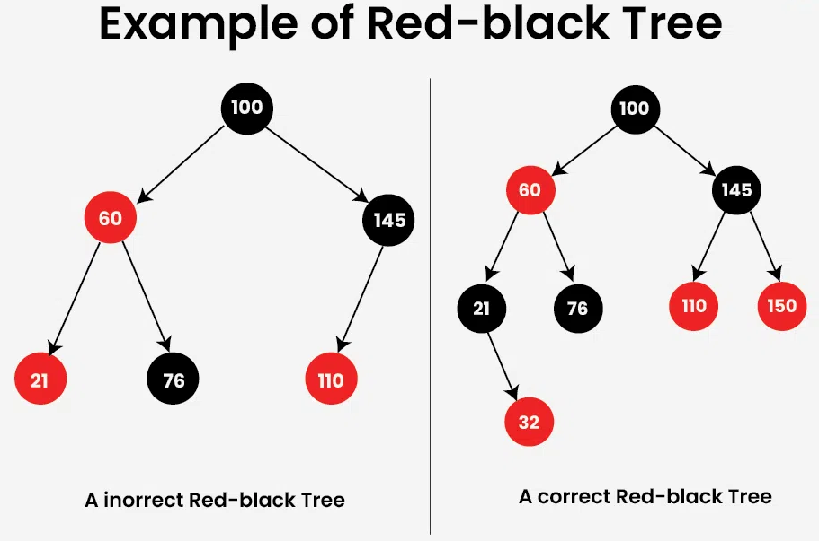
Red Black Tree
Red-Black Tree: The Correct Red-Black Tree in above image ensures that every path from the root to a leaf node has the same number of black nodes. In this case,​ there is one (excluding the root node).
The Incorrect Red Black Tree does not follow the red-black properties as two red nodes are adjacent to each other. Another problem is that one of the paths to a leaf node has zero black nodes, whereas the other two contain a black node.
Dr. Dattatray G. Takale, Department of Computer engineering, VIIT, Pune-48

Slide 40
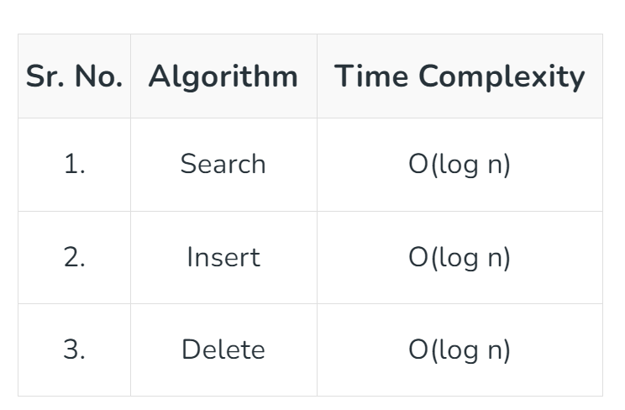
Red Black Tree
Why Red-Black Trees?
Most of the BST operations (e.g., search, max, min, insert, delete.. etc) take O(h) time where h is the height of the BST. The cost of these operations may become O(n) for a skewed Binary tree. If we make sure that the height of the tree remains O(log n) after every insertion and deletion, then we can guarantee an upper bound of O(log n) for all these operations. The height of a Red-Black tree is always O(log n) where n is the number of nodes in the tree.
Dr. Dattatray G. Takale, Department of Computer engineering, VIIT, Pune-48

Slide 41
Red Black Tree
Comparison with AVL Tree:
The AVL trees are more balanced compared to Red-Black Trees, but they may cause more rotations during insertion and deletion. So if your application involves frequent insertions and deletions, then Red-Black trees should be preferred. And if the insertions and deletions are less frequent and search is a more frequent operation, then AVL tree should be preferred over the Red-Black Tree.
Dr. Dattatray G. Takale, Department of Computer engineering, VIIT, Pune-48

Slide 42
Red Black Tree
1. Insertion
Inserting a new node in a Red-Black Tree involves a two-step process: performing a standard binary search tree (BST) insertion, followed by fixing any violations of Red-Black properties.
Insertion Steps
BST Insert: Insert the new node like in a standard BST.
Fix Violations:
If the parent of the new node is black, no properties are violated.
If the parent is red, the tree might violate the Red Property, requiring fixes.
Fixing Violations During Insertion
After inserting the new node as a red node, we might encounter several cases depending on the colors of the node’s parent and uncle (the sibling of the parent):
Case 1: Uncle is Red: Recolor the parent and uncle to black, and the grandparent to red. Then move up the tree to check for further violations.
Case 2: Uncle is Black:
Sub-case 2.1: Node is a right child: Perform a left rotation on the parent.
Sub-case 2.2: Node is a left child: Perform a right rotation on the grandparent and recolor appropriately.
Dr. Dattatray G. Takale, Department of Computer engineering, VIIT, Pune-48

Slide 43

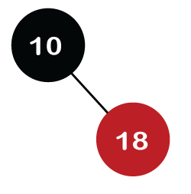
Red Black Tree
Let's understand the insertion in the Red-Black tree.
10, 18, 7, 15, 16, 30, 25, 40, 60
Step 1: Initially, the tree is empty, so we create a new node having value 10. This is the first node of the tree, so it would be the root node of the tree. As we already discussed, that root node must be black in color, which is shown below:
Step 2: The next node is 18. As 18 is greater than 10 so it will come at the right of 10 as shown below.
Dr. Dattatray G. Takale, Department of Computer engineering, VIIT, Pune-48

Slide 44
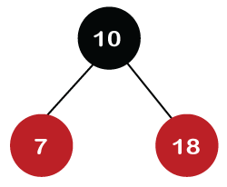
Red Black Tree
We know the second rule of the Red Black tree that if the tree is not empty then the newly created node will have the Red color. Therefore, node 18 has a Red color, as shown in the below figure:
Now we verify the third rule of the Red-Black tree, i.e., the parent of the new node is black or not. In the above figure, the parent of the node is black in color; therefore, it is a Red-Black tree.
Step 3: Now, we create the new node having value 7 with Red color. As 7 is less than 10, so it will come at the left of 10 as shown below.
Dr. Dattatray G. Takale, Department of Computer engineering, VIIT, Pune-48

Slide 45
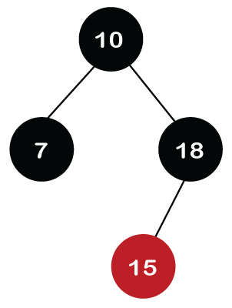
Red Black Tree
Step 4: The next element is 15, and 15 is greater than 10, but less than 18, so the new node will be created at the left of node 18. The node 15 would be Red in color as the tree is not empty.
The above tree violates the property of the Red-Black tree as it has Red-red parent-child relationship. Now we have to apply some rule to make a Red-Black tree. The rule 4 says that if the new node's parent is Red, then we have to check the color of the parent's sibling of a new node. The new node is node 15; the parent of the new node is node 18 and the sibling of the parent node is node 7. As the color of the parent's sibling is Red in color, so we apply the rule 4a. The rule 4a says that we have to recolor both the parent and parent's sibling node. So, both the nodes, i.e., 7 and 18, would be recolored as shown in the below figure.
Dr. Dattatray G. Takale, Department of Computer engineering, VIIT, Pune-48

Slide 46
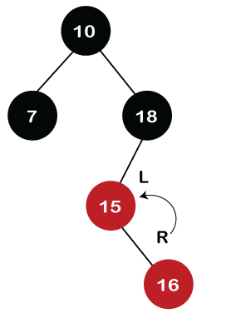
Red Black Tree
We also have to check whether the parent's parent of the new node is the root node or not. As we can observe in the above figure, the parent's parent of a new node is the root node, so we do not need to recolor it.
Step 5: The next element is 16. As 16 is greater than 10 but less than 18 and greater than 15, so node 16 will come at the right of node 15. The tree is not empty; node 16 would be Red in color, as shown in the below figure:
Dr. Dattatray G. Takale, Department of Computer engineering, VIIT, Pune-48

Slide 47
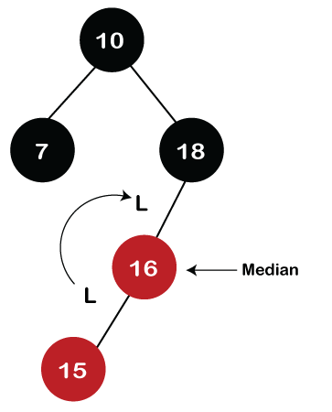
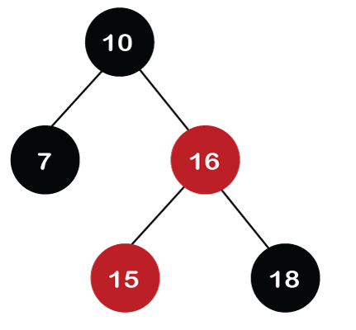
Red Black Tree
In the above figure, we can observe that it violates the property of the parent-child relationship as it has a red-red parent-child relationship. We have to apply some rules to make a Red-Black tree. Since the new node's parent is Red color, and the parent of the new node has no sibling, so rule 4a will be applied. The rule 4a says that some rotations and recoloring would be performed on the tree.
Since node 16 is right of node 15 and the parent of node 15 is node 18. Node 15 is the left of node 18. Here we have an LR relationship, so we require to perform two rotations. First, we will perform left, and then we will perform the right rotation. The left rotation would be performed on nodes 15 and 16, where node 16 will move upward, and node 15 will move downward. Once the left rotation is performed, the tree looks like as shown in the below figure:
Dr. Dattatray G. Takale, Department of Computer engineering, VIIT, Pune-48

Slide 48
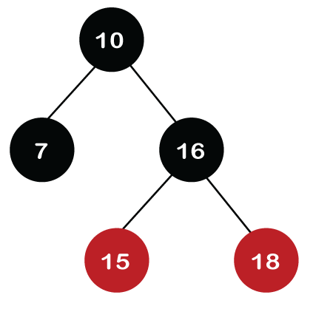
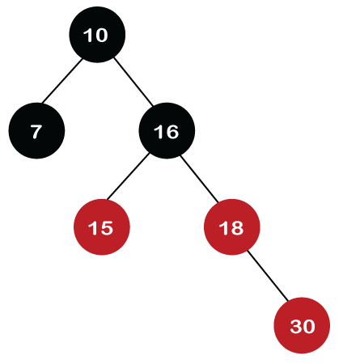
Red Black Tree
After rotation, node 16 and node 18 would be recolored; the color of node 16 is red, so it will change to black, and the color of node 18 is black, so it will change to a red color as shown in the below figure:
Step 6: The next element is 30. Node 30 is inserted at the right of node 18. As the tree is not empty, so the color of node 30 would be red.
Dr. Dattatray G. Takale, Department of Computer engineering, VIIT, Pune-48

Slide 49
Red Black Tree
In the above figure, we can observe that it violates the property of the parent-child relationship as it has a red-red parent-child relationship. We have to apply some rules to make a Red-Black tree. Since the new node's parent is Red color, and the parent of the new node has no sibling, so rule 4a will be applied. The rule 4a says that some rotations and recoloring would be performed on the tree.
Since node 16 is right of node 15 and the parent of node 15 is node 18. Node 15 is the left of node 18. Here we have an LR relationship, so we require to perform two rotations. First, we will perform left, and then we will perform the right rotation. The left rotation would be performed on nodes 15 and 16, where node 16 will move upward, and node 15 will move downward. Once the left rotation is performed, the tree looks like as shown in the below figure:
Dr. Dattatray G. Takale, Department of Computer engineering, VIIT, Pune-48

Slide 50
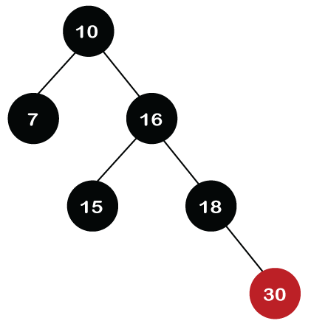
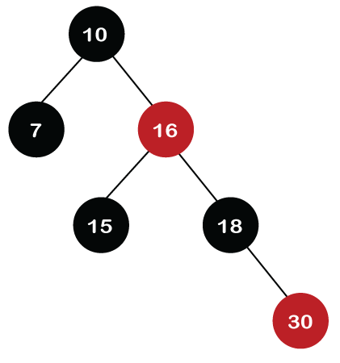
Red Black Tree
The color of the parent and parent's sibling of a new node is Red, so rule 4b is applied. In rule 4b, we have to do only recoloring, i.e., no rotations are required. The color of both the parent (node 18) and parent's sibling (node 15) would become black, as shown in the below image.
Dr. Dattatray G. Takale, Department of Computer engineering, VIIT, Pune-48

Slide 51
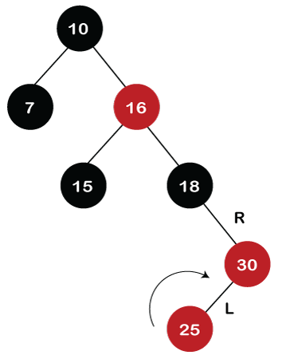
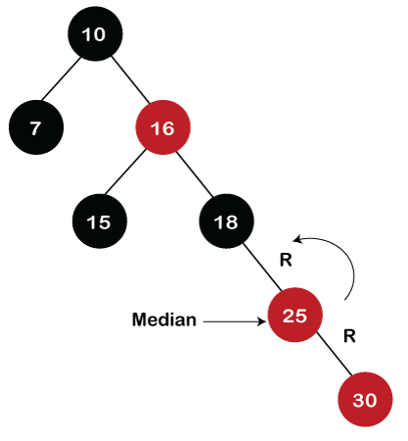
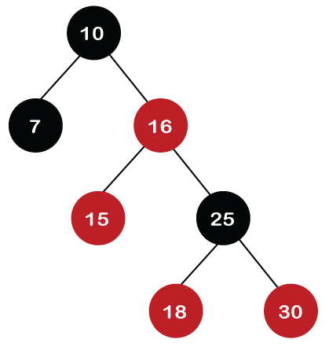
Red Black Tree
Step 7: The next element is 25, which we have to insert in a tree. Since 25 is greater than 10, 16, 18 but less than 30; so, it will come at the left of node 30. As the tree is not empty, node 25 would be in Red color. Here Red-red conflict occurs as the parent of the newly created is Red color.
Since there is no parent's sibling, so rule 4a is applied in which rotation, as well as recoloring, are performed. First, we will perform rotations. As the newly created node is at the left of its parent and the parent node is at the right of its parent, so the RL relationship is formed. Firstly, the right rotation is performed in which node 25 goes upwards, whereas node 30 goes downwards, as shown in the below figure.
Dr. Dattatray G. Takale, Department of Computer engineering, VIIT, Pune-48

Slide 52
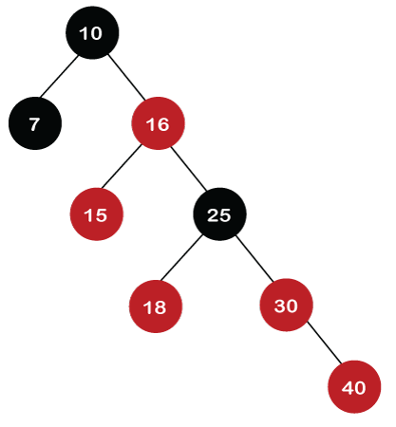

Red Black Tree
Step 8: The next element is 40. Since 40 is greater than 10, 16, 18, 25, and 30, so node 40 will come at the right of node 30. As the tree is not empty, node 40 would be Red in color. There is a Red-red conflict between nodes 40 and 30, so rule 4b will be applied.
As the color of parent and parent's sibling node of a new node is Red so recoloring would be performed. The color of both the nodes would become black, as shown in the below image.
After recoloring, we also have to check the parent's parent of a new node, i.e., 25, which is not a root node, so recoloring would be performed, and the color of node 25 changes to Red.
After recoloring, red-red conflict occurs between nodes 25 and 16. Now node 25 would be considered as the new node. Since the parent of node 25 is red in color, and the parent's sibling is black in color, rule 4a would be applied. Since 25 is at the right of the node 16 and 16 is at the right of its parent, so there is an RR relationship. In the RR relationship, left rotation is performed. After left rotation, the median element 16 would be the root node, as shown in the below figure.
Dr. Dattatray G. Takale, Department of Computer engineering, VIIT, Pune-48

Slide 53
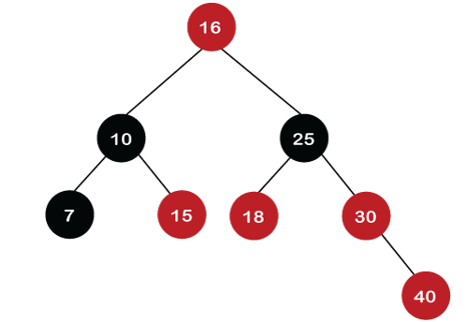




Red Black Tree
Dr. Dattatray G. Takale, Department of Computer engineering, VIIT, Pune-48

Slide 54
Red Black Tree
Comparison with AVL Tree:
The AVL trees are more balanced compared to Red-Black Trees, but they may cause more rotations during insertion and deletion. So if your application involves frequent insertions and deletions, then Red-Black trees should be preferred. And if the insertions and deletions are less frequent and search is a more frequent operation, then AVL tree should be preferred over the Red-Black Tree.
Dr. Dattatray G. Takale, Department of Computer engineering, VIIT, Pune-48

Slide 55

Heap Tree: Min Heap, Max Heap, Heap Sort
Introduction Heap
A heap data structure is a specialized binary tree used in DSA to efficiently manage priority queues. Here, we will discuss the basics of a heap tree in data structure, its types, and its significance in various algorithms, providing a foundational understanding for beginners.
There are two types of Heaps:
Min Heap: The value of the parent node is always less than or equal to the values of its children. The root node contains the smallest element.
Max Heap: The value of the parent node is always greater than or equal to the values of its children. The root node contains the largest element.
Dr. Dattatray G. Takale, Department of Computer engineering, VIIT, Pune-48

Slide 56


Heap Tree: Min Heap, Max Heap Introduction Heap
Characteristics of Heap Tree
A Heap Tree has the following important properties:
Complete Binary Tree:
All levels are completely filled except possibly the last.
Nodes are filled from left to right.
Heap Property
Determines the type of heap:
Max Heap :In a max-heap, each parent node is greater than or equal to its child nodes. This ensures that the largest value is always at the root of the tree.
Min Heap: In a min-heap, each parent node is less than or equal to its child nodes. This ensures that the smallest value is always at the root of the tree.
Array Representation:
Heaps are efficiently stored using arrays, not pointers.
Dr. Dattatray G. Takale, Department of Computer engineering, VIIT, Pune-48

Slide 57
Huffman Coding/Tree
Huffman Coding is a lossless data compression algorithm used to reduce the size of data without losing any information. It is a greedy algorithm that assigns variable-length binary codes to characters based on their frequency of occurrence.
Characters that occur more frequently are assigned shorter codes, while less frequent characters receive longer codes. This minimizes the total number of bits required to encode the data.
Huffman Coding is widely used in file compression formats such as ZIP, JPEG, PNG, MP3, and PDF.
Key Concepts
Lossless Compression
Original data can be perfectly reconstructed from the compressed data.
No information is lost during compression.
Variable-Length Encoding
Unlike ASCII (fixed 8 bits per character), Huffman Coding uses different bit lengths.
Improves compression efficiency.
Prefix Code
Huffman codes are prefix-free.
No code is a prefix of another code.
This ensures unambiguous decoding.
Dr. Dattatray G. Takale, Department of Computer engineering, VIIT, Pune-48

Slide 58
Huffman Coding/Tree
Huffman Tree
A Huffman Tree is a full binary tree used to represent Huffman codes.
Each leaf node represents a character.
Each internal node represents the sum of frequencies of its children.
Left edge is usually assigned 0, right edge 1 (or vice versa).
Dr. Dattatray G. Takale, Department of Computer engineering, VIIT, Pune-48

Slide 59


Step for Solving Huffman Coding/Tree
Dr. Dattatray G. Takale, Department of Computer engineering, VIIT, Pune-48

Slide 60


Step for Solving Huffman Coding/Tree
Dr. Dattatray G. Takale, Department of Computer engineering, VIIT, Pune-48

Slide 61


Huffman Tree
Dr. Dattatray G. Takale, Department of Computer engineering, VIIT, Pune-48

Slide 62
B Tree
B-Tree was developed in the year of 1972 by Bayer and McCreight with the name Height Balanced m-way Search Tree. Later it was named as B-Tree.
Index structures for large datasets cannot be stored in main memory
Storing it on disk requires different approach to efficiency
Motivation behind B Tree
Assume that we use an AVL tree to store about 20 million records
We end up with a very deep binary tree with lots of different disk accesses;
We know we can’t improve on the log n lower bound on search for a binary tree
But, the solution is to use more branches and thus reduce the height of the tree!
As branching increases, depth decreases
Dr. Dattatray G. Takale, Department of Computer engineering, VIIT, Pune-48

Slide 63
B Tree
A B-tree of order m is an m-way tree (i.e., a tree where each node may have up to m children) in which:
Balanced M-Way Tree
Generalized of BST in which a Node can have more than one key and more than 2 children
Maintain Sorted Data
All leaves are on the same level
Every node has max m children
Min Children is leaf: 0, Root: 2,
All non-leaf nodes except the root have at least [m / 2] children
The root is either a leaf node, or it has from two to m children
A leaf node contains no more than m – 1 keys
Dr. Dattatray G. Takale, Department of Computer engineering, VIIT, Pune-48

Slide 64
B Tree
B-tree is a special type of self-balancing search tree in which each node can contain more than one key and can have more than two children. It is a generalized form of the binary search tree.
A B-Tree is a self-balancing multiway search tree in which:
Each node can have more than two children
Keys inside a node are stored in sorted order
The tree remains balanced at all times
It is mainly used in databases and file systems.
Why B-Tree is Needed?
Binary Search Trees become inefficient for large data
Disk access is slow → B-Tree reduces disk I/O
Stores many keys in one node, minimizing tree height
Dr. Dattatray G. Takale, Department of Computer engineering, VIIT, Pune-48

Slide 65

B Tree
Properties of a B-Tree (Order = m)
B-Tree of order m has the following properties:
Each node can have at most m children
Each internal node (except root) has at least ⌈m/2⌉ children
Each node can store at most (m−1) keys
Keys inside a node are sorted
All leaf nodes are at the same level
Root has at least 2 children (unless it is a leaf)
Dr. Dattatray G. Takale, Department of Computer engineering, VIIT, Pune-48

Slide 66
Constructing a B-tree
Suppose we start with an empty B-tree and keys arrive in the following order:
1 12 8 2 25 6 14 28 17 7 52 16 48 68 3 26 29 53 55 45
We want to construct a B-tree of order 5
The first four items go into the root:
To put the fifth item in the root would overflow condition 5
Therefore, when 25 arrives, pick the middle key to make a new root
1
2
8
12
Dr. Dattatray G. Takale, Department of Computer engineering, VIIT, Pune-48

Slide 67
Constructing a B-tree (contd.)
8
1
2
12
25
6, 14, 28 get added to the leaf nodes:
8
1
2
6
12
14
25
28
Dr. Dattatray G. Takale, Department of Computer engineering, VIIT, Pune-48

Slide 68
Constructing a B-tree (contd.)
Adding 17 to the right leaf node would over-fill it, so we take the middle key, promote it (to the root) and split the leaf
8
17
1
2
6
12
14
25
28
7, 52, 16, 48 get added to the leaf nodes
8
17
1
2
6
7
12
14
16
25
28
48
52
Dr. Dattatray G. Takale, Department of Computer engineering, VIIT, Pune-48

Slide 69
Constructing a B-tree (contd.)
Adding 68 causes us to split the right most leaf, promoting 48 to the root, and adding 3 causes us to split the left most leaf, promoting 3 to the root; 26, 29, 53, 55 then go into the leaves
3
8
17
48
1
2
6
7
12
14
16
25
26
28
29
52
53
55
68
Adding 45 causes a split of
25
26
28
29
and promoting 28 to the root then causes the root to split
Dr. Dattatray G. Takale, Department of Computer engineering, VIIT, Pune-48

Slide 70
Constructing a B-tree (contd.)
17
3
8
28
48
1
2
6
7
12
14
16
25
26
29
45
52
53
55
68
Dr. Dattatray G. Takale, Department of Computer engineering, VIIT, Pune-48

Slide 71
Properties of B-Trees
Minimum children= (M/2)
Ex. Order 5 tree it’s (5/2)=3
Maximum children=M
Order 5 tree it’s 5
Minimum keys= (M/2)-1
Ex. Order 5 tree it’s (5/2)-1=2
Maximum keys=M-1
Order 5 tree it’s 4
Dr. Dattatray G. Takale, Department of Computer engineering, VIIT, Pune-48

Slide 72
Constructing a B-tree (contd.)
17
3
8
28
48
1
2
6
7
12
14
16
25
26
29
45
52
53
55
68
Dr. Dattatray G. Takale, Department of Computer engineering, VIIT, Pune-48

Slide 73
Constructing a B-tree (contd.)
17
3
8
28
48
1
2
6
7
12
14
16
25
26
29
45
52
53
55
68
Dr. Dattatray G. Takale, Department of Computer engineering, VIIT, Pune-48

Slide 74
Constructing a B-tree (contd.)
17
3
8
28
48
1
2
6
7
12
14
16
25
26
29
45
52
53
55
68
Dr. Dattatray G. Takale, Department of Computer engineering, VIIT, Pune-48

Slide 75
B Tree
a
* 9 *
f
g
* 3 * 7 *
* 13 *
b
d
h
c
e
* 1 * 2 *
* 4 * 5 *
* 8 *
* 10 * 12 *
* 21 *
B tree Of order 4
Minimum Keys: 1
Maximum keys 3
Minimum children: 2
Maximum children 4
Dr. Dattatray G. Takale, Department of Computer engineering, VIIT, Pune-48

Slide 76
Delete 2 Case 1: Deletion from a Leaf Node (Simple Case) Node has more than min. number of keys
Condition
The key to be deleted is in a leaf node
After deletion, the node still has at least the minimum number of keys
Action
Simply remove the key
No restructuring required
* 9 *
a
f
g
* 3 * 7 *
* 13 *
b
d
h
c
e
* 1 *
* 4 * 5 *
* 8 *
* 10 * 12 *
* 21 *
2 deleted directly. Node b can loose an element without underflow.
Dr. Dattatray G. Takale, Department of Computer engineering, VIIT, Pune-48

Slide 77



Dr. Dattatray G. Takale, Department of Computer engineering, VIIT, Pune-48

Slide 78



Dr. Dattatray G. Takale, Department of Computer engineering, VIIT, Pune-48

Slide 79
Delete 21 Case: Consider Left Sibling (Delete 21)
* 9 *
a
f
g
* 3 * 7 *
* 13 *
b
d
h
c
e
* 1 *
* 4 * 5 *
* 8 *
* 10 * 12 *
* 21 *
Consider left sibling as more keys are there. Rearrange nodes.
Dr. Dattatray G. Takale, Department of Computer engineering, VIIT, Pune-48

Slide 80
Delete 21 Case: Consider Left Sibling
* 9 *
a
f
g
* 3 * 7 *
* 12 *
b
d
h
c
e
* 1 *
* 4 * 5 *
* 8 *
* 10 *
* 13 *
Deleting 21 causes node e to underflow, so elements are redistributed between nodes c, g, and e
Dr. Dattatray G. Takale, Department of Computer engineering, VIIT, Pune-48

Slide 81
Delete 1 Case: Consider Right Sibling (delete 1)
* 9 *
a
f
g
* 3 * 7 *
* 12 *
b
d
h
c
e
* 1 *
* 4 * 5 *
* 8 *
* 10 *
* 13 *
Deleting 1 causes node b to underflow, so elements are redistributed between nodes b, f, and d
Dr. Dattatray G. Takale, Department of Computer engineering, VIIT, Pune-48

Slide 82
Delete 1 Case: Consider Right Sibling
* 9 *
a
f
g
* 4 * 7 *
* 12 *
b
d
h
c
e
* 3*
* 5 *
* 8 *
* 10 *
* 13 *
Deleting 1 causes node b to underflow, so elements are redistributed between nodes b, f, and d
Dr. Dattatray G. Takale, Department of Computer engineering, VIIT, Pune-48

Slide 83
Delete 1 Case: Consider Right Sibling
* 7 *
a
f
g
* 4 *
* 9*
b
d
h
e
* 3*
* 5 *
* 8 *
12 * 13 *
Dr. Dattatray G. Takale, Department of Computer engineering, VIIT, Pune-48

Slide 84
Delete 3 Case: Consider Right Sibling
* 7 * 9 *
d
h
e
* 4 * 5 *
* 8 *
12 * 13 *
Dr. Dattatray G. Takale, Department of Computer engineering, VIIT, Pune-48

Slide 85
Operation on B Tree
Advantages of B-Tree
Always balanced
Efficient disk access
Faster searching for large datasets
Suitable for databases and file systems
Disadvantages of B-Tree
Complex insertion and deletion
Not efficient for small data
More memory required per node
Applications of B-Tree
Database indexing
File systems
Operating systems
Large-scale storage systems
Disk-based searching
Operations on B-Tree
Search
Similar to BST but within a node
Time Complexity: O(log n)
Insertion
Steps:
Insert key in appropriate leaf node
If node overflows (keys > m−1):
Split the node
Move middle key to parent
Repeat until balance is restored
Deletion
Steps:
Remove key from leaf or internal node
If node underflows:
Borrow key from sibling OR
Merge nodes
Ensure all properties are maintained
Dr. Dattatray G. Takale, Department of Computer engineering, VIIT, Pune-48

Slide 86

B+ Tree
B+ tree is an extension of the B tree.
The difference in B+ tree and B tree is that in B tree the keys and records can be stored as internal as well as leaf nodes whereas in B+ trees, the records are stored as leaf nodes and the keys are stored only in internal nodes.
The records are linked to each other in a linked list manner.
This arrangement makes the searches of B+ trees faster and efficient.
Internal nodes of the B+ tree are called index nodes.
B-Tree stores data in all nodes, whereas B+-Tree
stores data only in leaf nodes.
Dr. Dattatray G. Takale, Department of Computer engineering, VIIT, Pune-48

Slide 87

B+ Tree
A B+ Tree is a balanced multiway search tree used mainly in databases and file systems.
Key Idea (Very Important)
All actual data (keys/records) are stored only in leaf nodes
Internal nodes store only keys for searching
Leaf nodes are linked together (like a linked list)
Basic Properties of B+ Tree
Assume order = m
Maximum children per internal node = m
Maximum keys per node = m − 1
All leaf nodes are at the same level
Leaf nodes are linked for sequential access
Dr. Dattatray G. Takale, Department of Computer engineering, VIIT, Pune-48

Slide 88
B+ Tree
Steps for Constructing a B+ Tree
Step 1: Decide the Order of the B+ Tree
Let the order be m
Maximum keys per node = m − 1
Minimum keys per leaf node = ⌈(m − 1)/2⌉
All leaf nodes must be at the same level
Step 2: Start with an Empty Tree
Initially, the B+ Tree has only one node
This node acts as both root and leaf
Step 3: Insert Keys One by One
Insert keys in sorted order
Always insert keys into leaf nodes only
Step 4: Check for Overflow in Leaf Node
If the number of keys ≤ (m − 1) → No problem
If keys > (m − 1) → Overflow occurs
Step 5: Split the Leaf Node (If Overflow Occurs)
Divide the keys into two leaf nodes
Left node gets first ⌈(m)/2⌉ keys
Right node gets remaining keys
Copy the first key of the right node to the parent
Maintain leaf node links
Step 6: Insert Key into Parent Node
Insert the copied key into the parent node
Parent node acts as an index
Step 7: Handle Parent Overflow
If parent node overflows:
Split the internal node
Push the middle key upward
Repeat this process recursively up to the root
Step 8: Create New Root (If Required)
If the root node overflows:
Create a new root
Increase tree height by 1
Step 9: Maintain Leaf-Level Linking
After every insertion or split:
Ensure leaf nodes remain linked
Supports sequential and range queries
Dr. Dattatray G. Takale, Department of Computer engineering, VIIT, Pune-48

Slide 89



Deletion in B+ Tree
Dr. Dattatray G. Takale, Department of Computer engineering, VIIT, Pune-48

Slide 90


Deletion in B+ Tree
Dr. Dattatray G. Takale, Department of Computer engineering, VIIT, Pune-48

Slide 91

Difference in B and B+ Tree
Dr. Dattatray G. Takale, Department of Computer engineering, VIIT, Pune-48

Slide 92
Splay Tree
A Splay Tree is a self-adjusting Binary Search Tree (BST) in which the most recently accessed node is moved to the root using rotations. This process is called splaying.
Key Idea
Frequently used elements stay near the root → faster future access.
Features of Splay Tree
No extra balance information (unlike AVL/Red-Black)
Every search, insert, or delete operation performs splaying
Recently accessed elements become faster to access
Average time complexity: O(log n)
A Splay Tree is a special type of Binary Search Tree (BST) that moves the recently accessed element to the root.
Every time you:
Search
Insert
Delete
The accessed node is brought to the root using rotations. This process is called Splaying.
Dr. Dattatray G. Takale, Department of Computer engineering, VIIT, Pune-48

Slide 93
Splay Tree
Why Splay Tree?
In real life, some data is used more frequently.
Example:
Recently opened files
Recently searched contacts
Recently used cache items
If frequently used items stay near the root → operations become faster.
Key Idea:
Recently used element becomes fastest to access.
Properties of Splay Tree
It is a Binary Search Tree
No balance factor (simpler than AVL)
After every operation → node is moved to root
Average time complexity: O(log n)
What is Splaying?
Splaying = Moving a node to the root using rotations
There are 3 cases.
Dr. Dattatray G. Takale, Department of Computer engineering, VIIT, Pune-48

Slide 94



Splay Tree
Dr. Dattatray G. Takale, Department of Computer engineering, VIIT, Pune-48

Slide 95



Splay Tree
Dr. Dattatray G. Takale, Department of Computer engineering, VIIT, Pune-48

Slide 96

Van Emde Boas Tree
Dr. Dattatray G. Takale, Department of Computer engineering, VIIT, Pune-48

Slide 97


Van Emde Boas Tree
Dr. Dattatray G. Takale, Department of Computer engineering, VIIT, Pune-48

Slide 98

Van Emde Boas Tree
Dr. Dattatray G. Takale, Department of Computer engineering, VIIT, Pune-48

Slide 99


Van Emde Boas Tree
Dr. Dattatray G. Takale, Department of Computer engineering, VIIT, Pune-48

Slide 100



Dr. Dattatray G. Takale, Department of Computer engineering, VIIT, Pune-48

Slide 101


Dr. Dattatray G. Takale, Department of Computer engineering, VIIT, Pune-48

Slide 102

Fusion Tree
A Fusion Tree is an advanced data structure used for very fast searching and sorting of integers.
It was introduced to improve the performance of search operations beyond the normal limits of Binary Search Trees and B-Trees.
Basic Idea
Normally:
Binary Search Tree → O(log n)
B-Tree → O(log n)
But Fusion Tree performs search in:
$$O\left(\log{n}/\log{w}\right)$$
Where:
w = word size of the machine (number of bits, e.g., 32 or 64)
👉 This makes searching faster than O(log n).
Dr. Dattatray G. Takale, Department of Computer engineering, VIIT, Pune-48

Slide 103
Fusion Tree
Key Features of Fusion Tree
Multiway search tree (similar to B-Tree)
Uses machine word operations
Performs multiple comparisons at once
Supports:
Search
Insert
Delete
Predecessor
Successor
Time Complexity
Operation | Time
Search | O(log n / log w)
Insert | O(log n / log w)
Delete | O(log n / log w)
Dr. Dattatray G. Takale, Department of Computer engineering, VIIT, Pune-48

Slide 104
Fusion Tree
Uses of Fusion Tree
Fast Searching in Large Databases
High-Performance Computing
Network Routing Systems
Computational Geometry
Limitations (Important)
Very complex implementation
Uses advanced bit operations
Not practical for small datasets
Mostly theoretical or specialized use
Dr. Dattatray G. Takale, Department of Computer engineering, VIIT, Pune-48

Slide 105

Dynamic Finger Search Trees
Normally, in search trees like:
Binary Search Tree
AVL Tree
Red-Black Tree
The search time is:
$$O\left(\log{n}\right)$$
This time is same, no matter where the element is located.
But in many real-life situations:
We search nearby elements repeatedly
Example:
Searching consecutive numbers
Moving forward/backward in sorted data
👉 Dynamic Finger Search Trees are designed to make such searches faster.
What is a Dynamic Finger?
A finger means:
A pointer/reference to a recently accessed node.
Instead of always searching from the root, we search:
From the last accessed position
If the new element is close → search is faster
Dr. Dattatray G. Takale, Department of Computer engineering, VIIT, Pune-48

Slide 106

Dynamic Finger Search Trees
A Dynamic Finger Search Tree is a search tree where the search time depends on the distance between the current element and the previously accessed element, not the total size of the tree.
Time Complexity
Search time:
$$O\left(\log{d}\right)$$
Where:
d = distance between the current key and the previous key in sorted order
Meaning:
If element is close → very fast
If element is far → normal O(log n)
Advantages
Faster for local searches
Good for sequential access
Adaptive to access pattern
Improves performance in practice
Dr. Dattatray G. Takale, Department of Computer engineering, VIIT, Pune-48

